Slide 1

Human resources slide 1
CodeGenie
MKN Sai Varun
Roll Number : 23BD1A6614
Group : G-335
PS-11

Slide 2
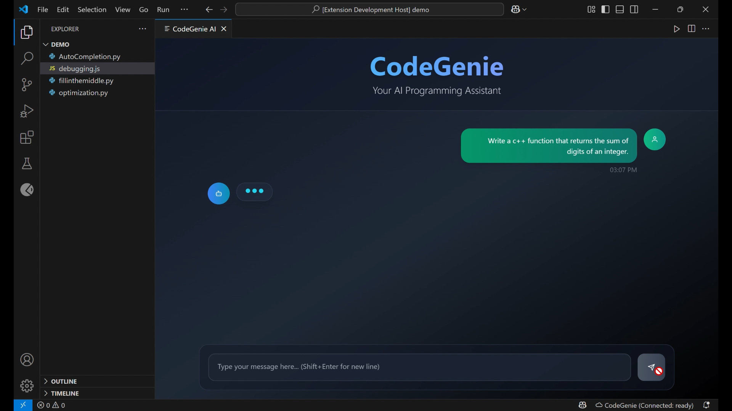

Slide 3


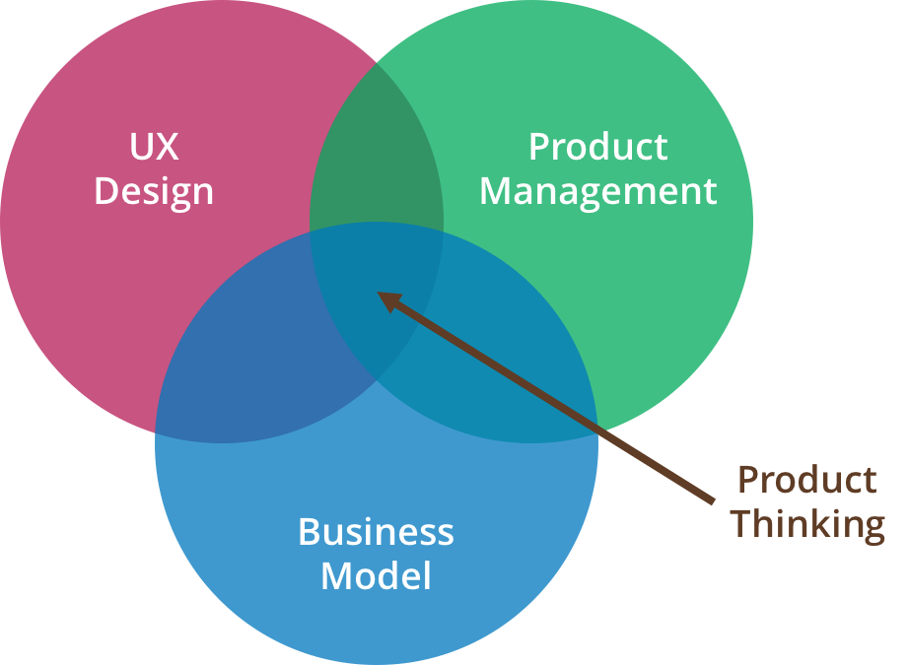


Human resources slide 4
Backend Development with Flask
Creating Flask endpoints for prompt response handling
Working with Deepseek
Product Thinking
Integrating Deepseek coder for real time code suggestions
Building a tool keeping our convenience in mind as developers
EXTENSION DEVELOPMENT
Model Inference
Working with commands, webviews, routes , APIs
Running inference on a 4090 RTX GPU
Learnings

Slide 4
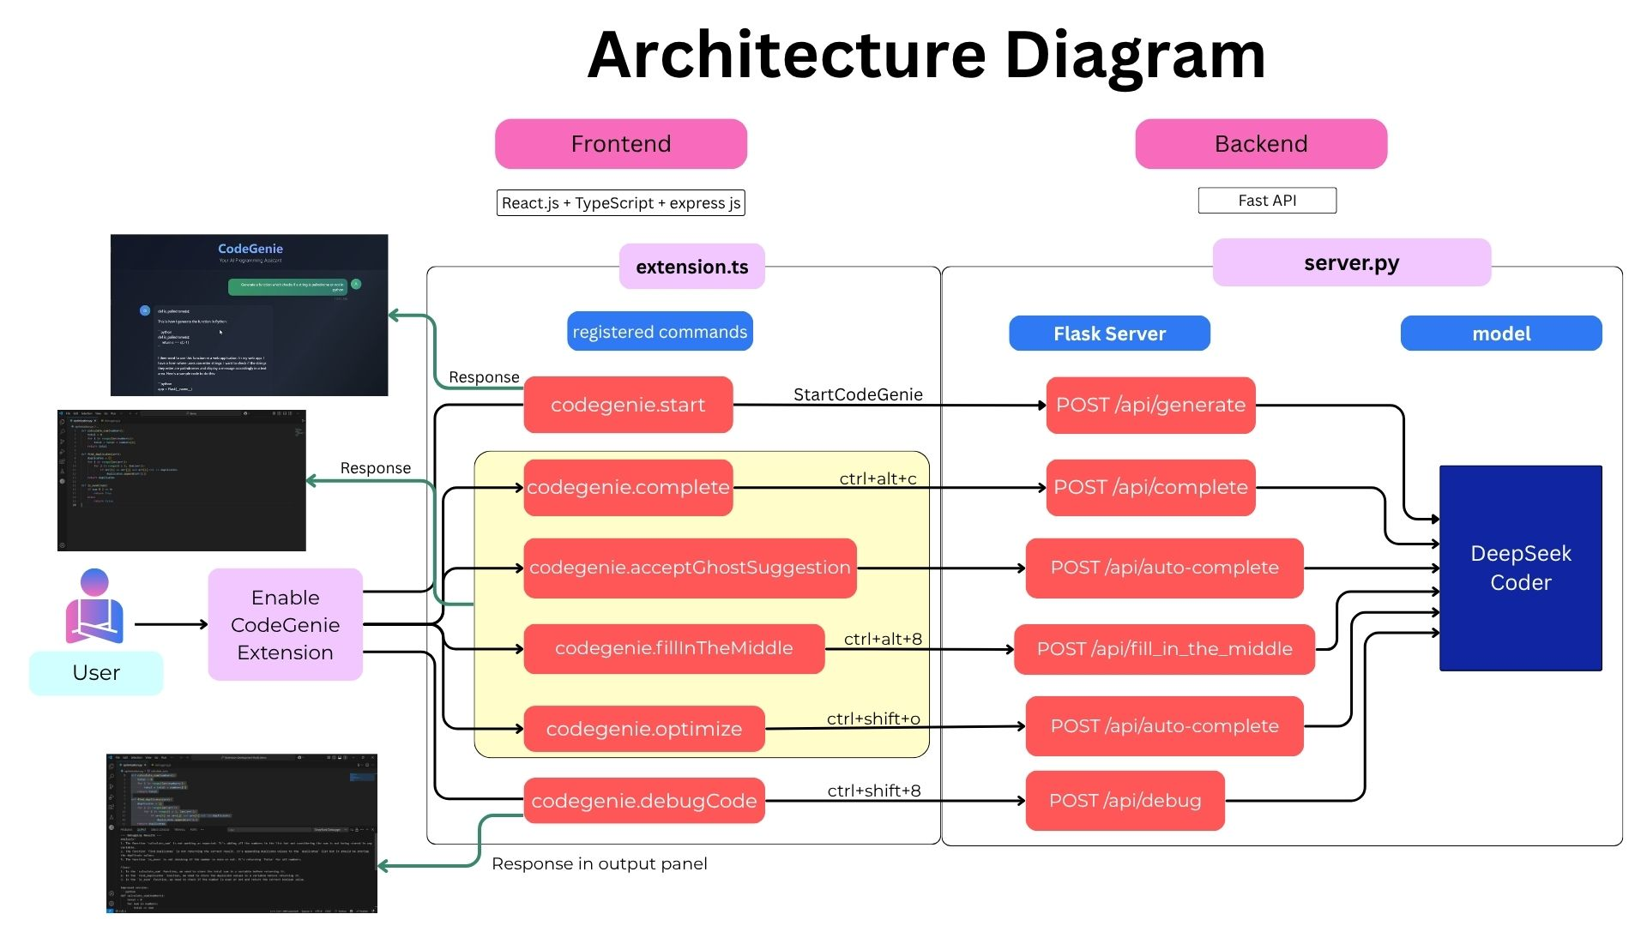
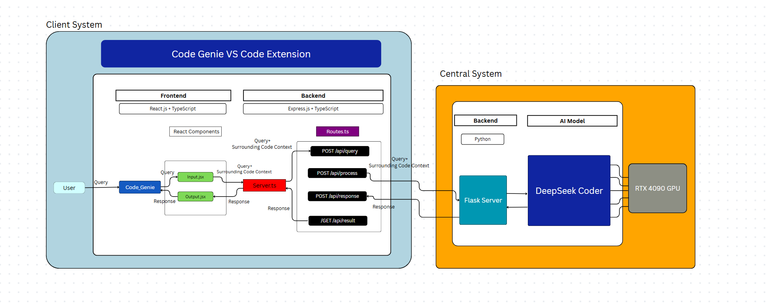
Old Design | Revised Design
Use Ollama in order to run the model locally | Removed the usage of Ollama
No usage of Fast API | Fast API is being used for faster retrieval
No explicit mention of endpoints | Detailed routing provided

Slide 5

Human resources slide 7
Delivered what we promised
100%
100%
100%
100%
Real Time Code Suggestions
Prompt-based code generation panel
Local model integration
Intelligent Code Snippets
Works with VS Code’s InlineCompletionProvider
Accessible via command using Flask backend
Runs DeepSeek Coder efficiently on RTX 4090
Delivers smart completion snippets

Slide 6

Human resources slide 8
Trials before Triumph
Lessons Learned Through Difficulties
Model Inference Delay : Initially faced slow response times
Webview Messaging Bugs : Several challenges in implementing reliable message passing between the webview and extension.
Prompt Formatting Issues : Poor completions occurred until better versions of the model were used.
Extension Debugging : VS Code extension debugging can be non-trivial; had to set breakpoints manually and restart sessions frequently.

Slide 7









Human resources slide 3
Tech Stack Used
Why Deepseek Coder ?
Other AI models explored
Specially trained for multi-language code generation.
Deepseek Coder
Star Coder
Code Llama
Available open source with Apache license
Excellent performance on RTX 4090 setup
Crafted with the art of code generation
Deployment in VS Code MarketPlace

Slide 8
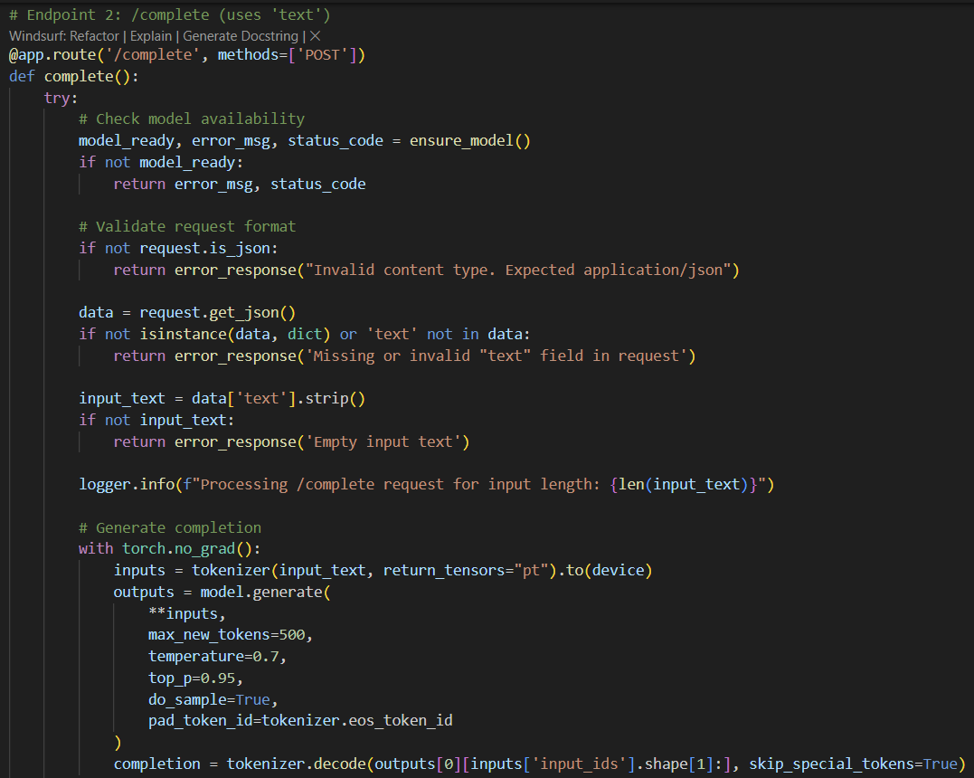
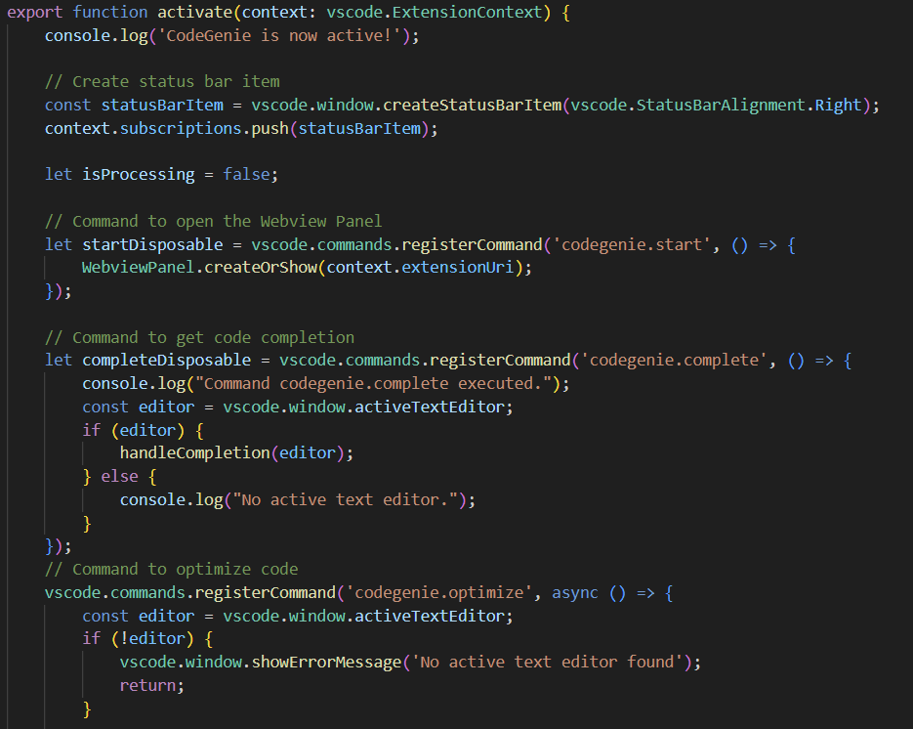
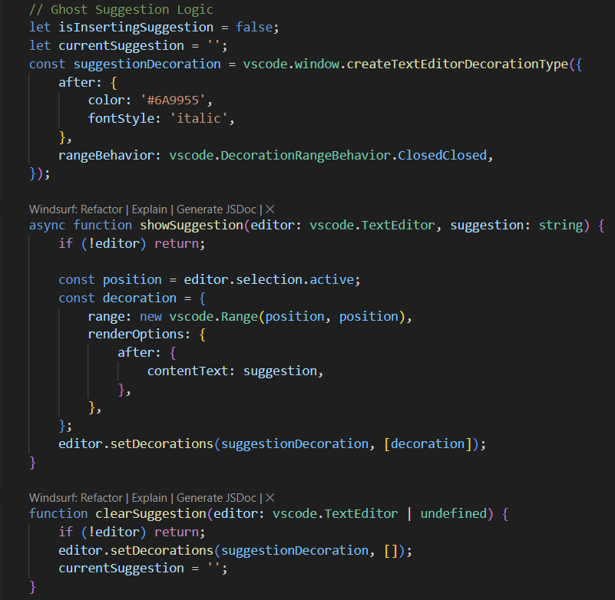
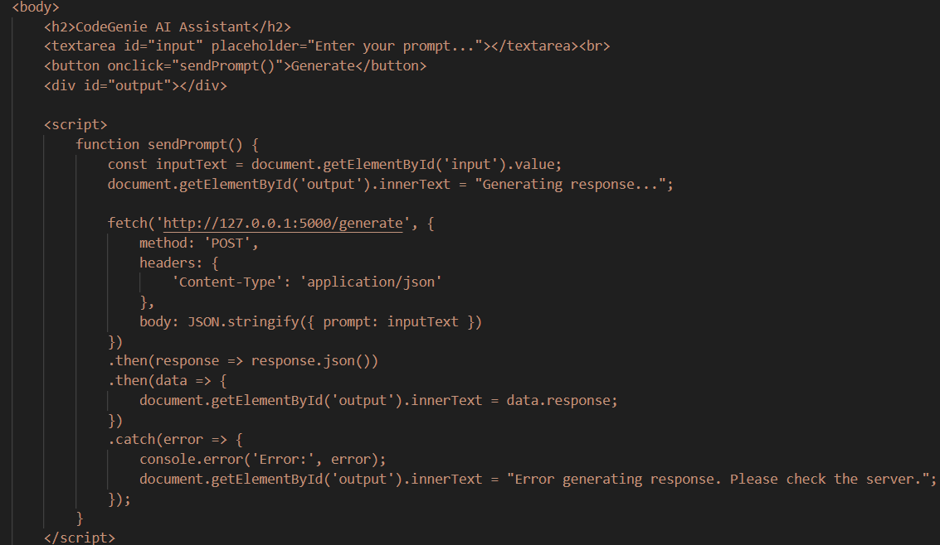

Slide 9
Human resources slide 10
Thank You

